Slide 1

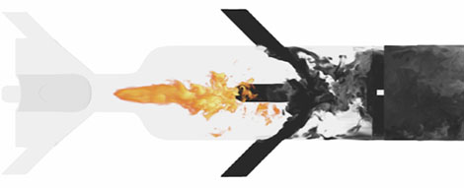
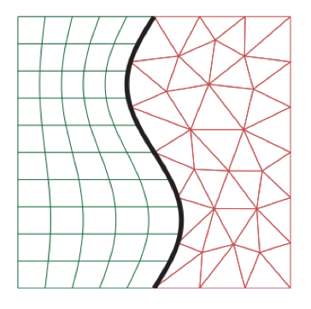
Time Integration of Reacting Flows and Energy-Stable Hybrid Spatial Discretizations
Cory Mikida (AE)
Preliminary Exam (Thursday, February 25th, 2021)

Slide 2

Goals for This Presentation
Ablation test (VKI)

Slide 3
Goals for This Presentation
Fill in any “gaps” in the proposal document
Ablation test (VKI)

Slide 4
Goals for This Presentation
Fill in any “gaps” in the proposal document
Expound upon certain aspects of both topics, namely current work
Ablation test (VKI)

Slide 5
Goals for This Presentation
Fill in any “gaps” in the proposal document
Expound upon certain aspects of both topics, namely current work
More extensively motivate how I hope to spend the “best days of my life”
Ablation test (VKI)

Slide 6
Time Integration of Reacting Flows

Slide 7
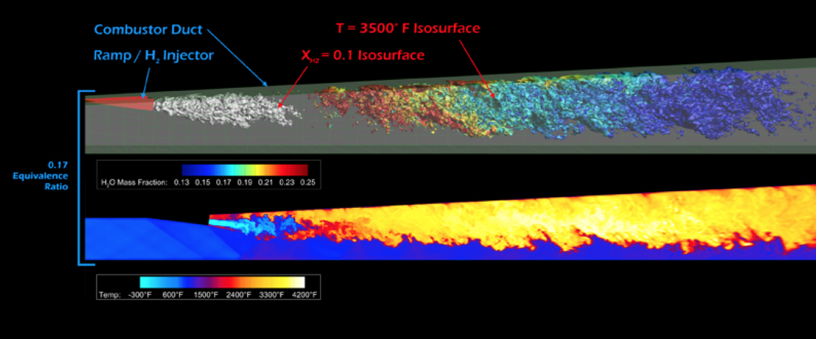
Motivation and Background
LES Modeling of nine-species, nineteen-reaction hydrogen-air combustion mechanism. Source: NASA@SC12
Ablation test (VKI)

Slide 8
Motivation and Background
Time integration of chemically reacting flows presents a significant set of simulation challenges
Presence of stiff terms limits timestep – fluid-relevant timescale is much larger than reaction timescale
Going fully explicit -> wasteful work
Going implicit -> restrictive solve requirements
One common approach: operator splitting
What numerical tools exist that allow us to do better?
Ablation test (VKI)

Slide 9
Motivation and Background
IMEX schemes, e.g. additive Runge-Kutta schemes of Kennedy and Carpenter [1]
Designed primarily for convection-diffusion-reaction equations
Higher order (can be lost when simulating DAEs)
Timestepping limitations removed, but timescales not easily split
Multi-rate schemes, e.g. multi-rate multistep schemes derived from Gear and Wells [2]
Splitting of timescales comes from per-component history management on different intervals
Mixing of implicitly and explicitly advanced components not yet accomplished/unexplored
Ablation test (VKI)

Slide 10
Motivation and Background
Given: an existing framework for multi-rate integration that has been proven effective for fully-explicit time advancement
Timescale splitting -> apply CFL condition to overset meshes
Component coupling -> energy-stable penalty-based interpolation
Implementation: Python packages for code generation of multi-rate integrators as well as a number of other schemes, some of which are implicit/incorporate implicit solves
Consider: combining performance improvement capabilities of multi-rate integration with flexibility of treating different right-hand sides implicitly or explicitly
Ablation test (VKI)

Slide 11
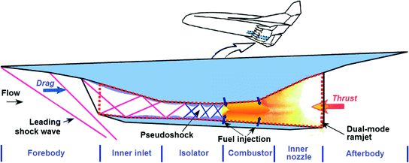
Motivation and Background
Potential impact: challenge existing state-of-the-art for CFD simulation of reacting flows -> produce faster and more accurate turnaround for…
Combustion for propulsion: scramjets/ramjets
Problems in atmospheric sciences -> climate concerns
Furnaces/residential heating -> energy efficiency
Source: Modeling and Simulation of Turbulent Combustion, Sabelnikov & Valsenko
Ablation test (VKI)

Slide 12
The Topic/Problem
The mission statement: develop efficient, accurate, and stable time integration schemes for reacting flows
Efficient: splitting of timescales via multi-rate
Accurate and Stable: high-order temporal resolution, with flexibility to advance separate components implicitly or explicitly, as well as adaptivity introduced via local error-informed timestep control
Gauging efficacy: comparison with existing methods, stress-testing with appropriately stiff demonstrative problems
Ablation test (VKI)

Slide 13
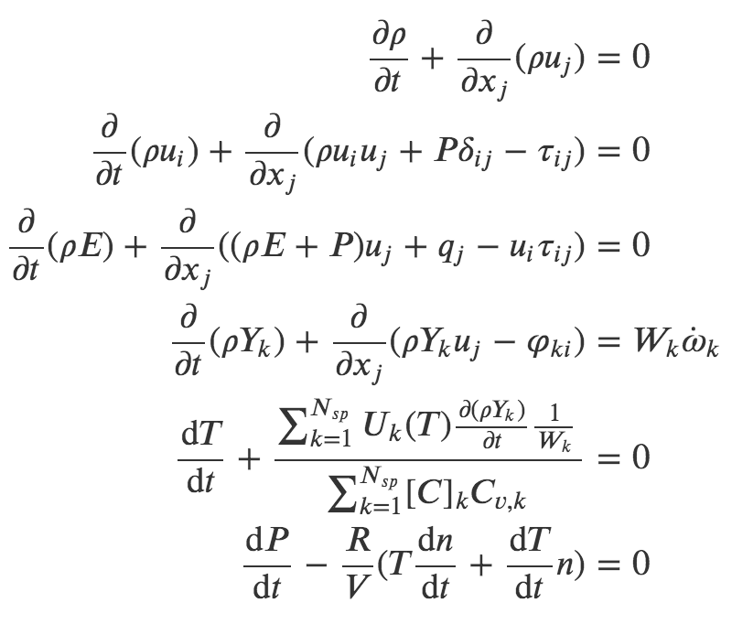
Governing Equations
Navier-Stokes equations with added equations for mass fraction evolution, as well as pressure/temperature evolution
In these equations:
𝜌 = density
u_{i} = velocity in ith direction
𝛿_{ij} = Kronecker delta
𝜏_{ij} = fluid stress tensor
E = total energy
T = temperature
P = pressure
q = heat flux
W_{k} = molecular weight of kth species
ὠ_{k} = production rate of kth species
R = gas constant
n = number of moles of gas
[C]_{k} = concentration of kth species
C_{v,k} = specific heat at constant volume of kth species
U_{k}(T) = internal energy of kth species at temperature T
Y_{k} = mass fraction of kth species
𝜑_{ki} = diffusion flux of kth species
Ablation test (VKI)

Slide 14
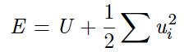
Governing Equations (2)
Primary stiffness contribution is of course from the mass fraction evolution equations – in particular our focus is on RHS
Pressure and temperature updates typically come from energy relation/EOS:
For now, we instead adopt time rate of changes for these quantities based on operator-splitting approach (constant internal energy/volume in reaction substep)
Ablation test (VKI)

Slide 15
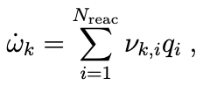
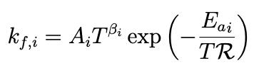
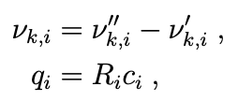
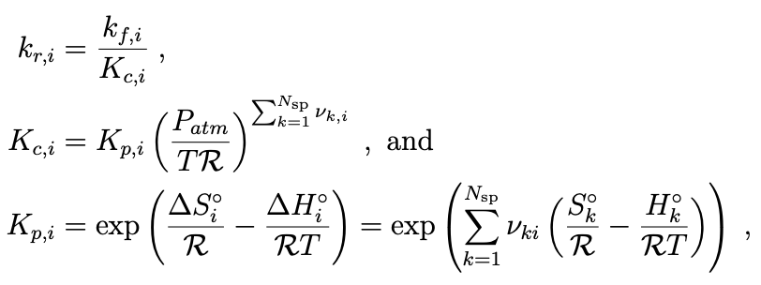
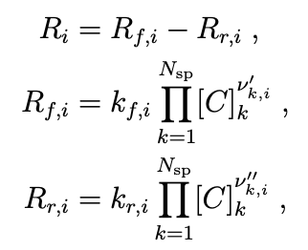
Gap: Species Production Rates
Species production rates: Arrhenius rates
Ablation test (VKI)

Slide 16
Numerics: Multi-Rate Integration
Solve y’ = a(t,y)…split into fast/slow terms
Multi-step methods: construct an approximation of a, ã based on history of past values
Adams-Bashforth: construct ã using polynomial interpolation (explicit)
For multi-rate: each a term in RHS has its own history, speed of evolution
y_{n+1} obtained by integrating ã
ã
Ablation test (VKI)

Slide 17
Numerics: Multi-Rate Integration (2)
Solve y’ = a(t,y)…split into fast/slow terms
Multi-step methods: construct an approximation of a, ã based on history of past values
Adams-Moulton: construct ã using polynomial interpolation (implicit)
For multi-rate: each a term in RHS has its own history, speed of evolution
y_{n+1} obtained by integrating ã
ã

Slide 18
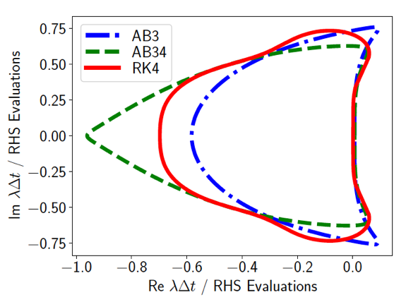
Numerics: Multi-Rate Integration (3)
Design choices for scheme synthesis include:
Choice of timescale splitting – which components are fast-evolving, which are slow
Step ratio
Evaluation order: “fastest-first” vs. “slowest-first”
When to re-extrapolate
How much history to include: stability implication
Source: Mikida et al. [3]

Slide 19
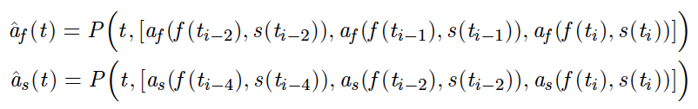
Gap: Multi-Rate Example
A walk-through of a macro-step with a simplified system…
Fastest-first scheme, step ratio H/h of 2
Step 1: Form polynomial extrapolants for both right-hand sides

Slide 20
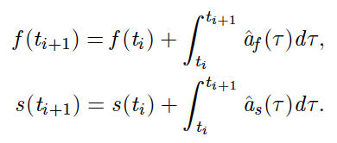
Gap: Multi-Rate Example (2)
Step 2: Integrate both extrapolants through one microstep
Step 3: Evaluate a_{f} at t_{i+1}
Step 4: Update polynomial extrapolant for a_{f} to include new history

Slide 21
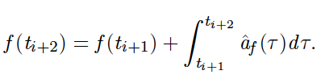
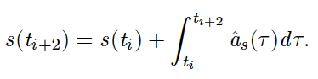
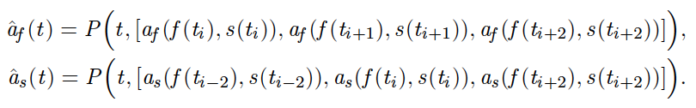
Gap: Multi-Rate Example (3)
Step 5: Integrate fast extrapolant through one microstep; integrate slow extrapolant through one macrostep
Step 6: Evaluate a_{f} and a_{s} at t_{i+2}
Step 7: Update polynomial extrapolants to include new history

Slide 22
Numerics: Multi-Rate Integration (4)
Summary: reduction in total RHS evaluations is achieved by evaluating fast RHS twice as often as the slow RHS
The key to the method is maintenance of histories at differing timestep intervals
Initial histories are obtained via “bootstrapping” with Runge-Kutta methods of matching order
Pictorial representations of macrostep process given in Klöckner [4] for a number of different configurations
What about application to chemistry/inclusion of implicit evaluation?

Slide 23
Numerics: Multi-Rate Chemistry
Revisit the governing equations: need to identify fast and slow components and coupling/self-influencing right-hand sides
Species production rates are a clear stiff/fast RHS, but what other state components depend on them directly?
Ablation test (VKI)

Slide 24
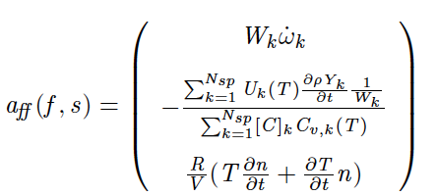
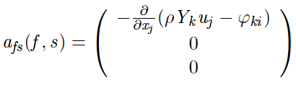
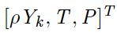
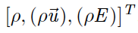
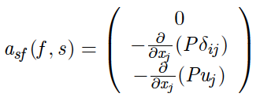
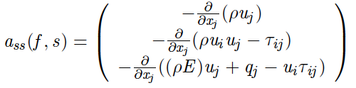
Numerics: Multi-Rate Chemistry (2)
With this possible splitting, right-hand side terms become:

Slide 25
Numerics: Multi-Rate Chemistry (3)
This is one possible setup, and its efficacy is currently undetermined
Timescales of certain components and right-hand sides (energy, mass diffusion) somewhat unknown – mechanism specificity?
Rates of coupling terms are a design choice to be determined
Pressure and temperature right-hand sides still predicated upon operator splitting approach – their use will be clarified
Different splittings, step ratios, orders, schema are easily implemented via code generation approach (Leap [5], Dagrt [6])
Ablation test (VKI)

Slide 26
Numerics: Implicit Chemistry
Given the stiffness of the chemistry that motivates this time integrator development, a natural inclusion in our framework is the ability to advance implicitly
Ablation test (VKI)

Slide 27
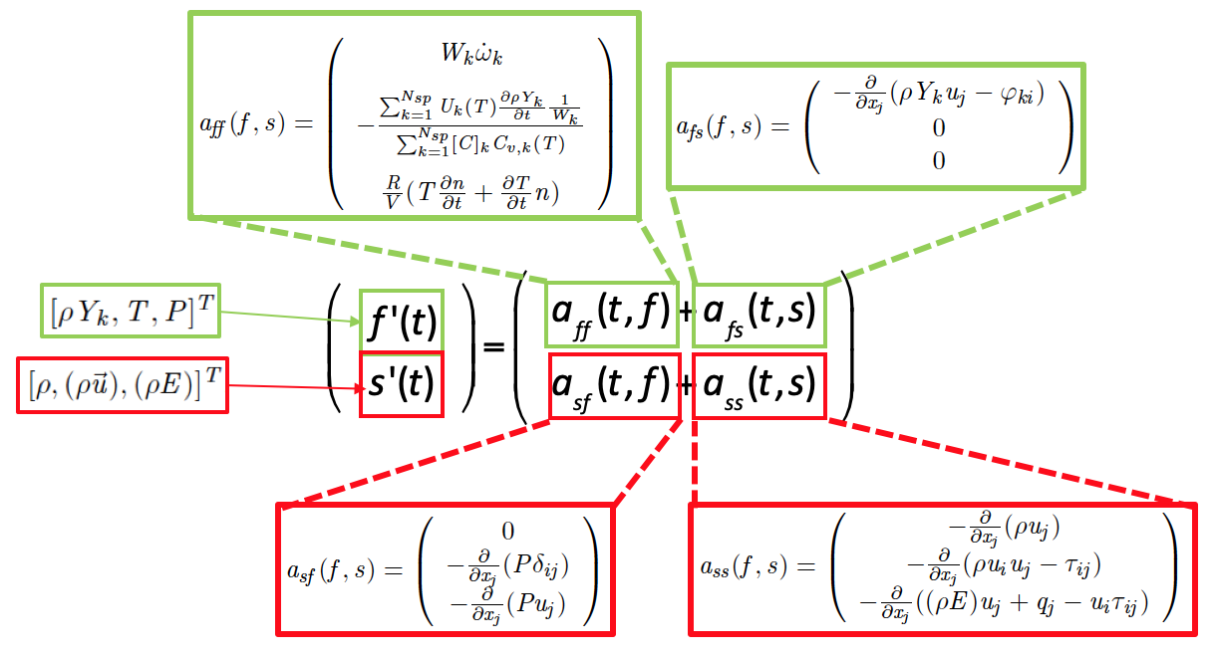
Numerics: Implicit Chemistry
Given the stiffness of the chemistry that motivates this time integrator development, a natural inclusion in our framework is the ability to advance implicitly

Slide 28
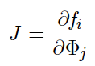
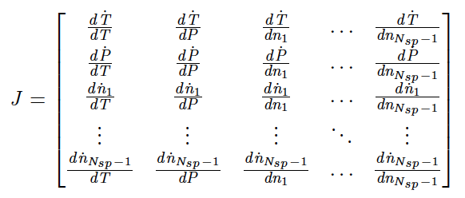
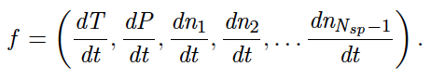
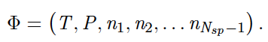
Numerics: Implicit Chemistry (2)
Key need: Jacobian for the chemistry right-hand sides
CVODE [7]/operator-splitting approach uses a finite-difference Jacobian
Being able to calculate actual Jacobian may have simulation value
This motivates the selection of temperature and pressure right-hand sides based on an operator-splitting approach
PyJac-V2: code generation of source terms and Jacobians [8]

Slide 29
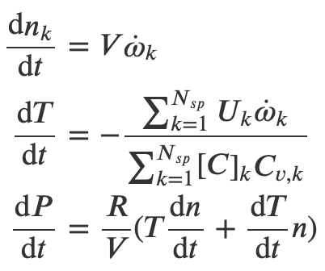
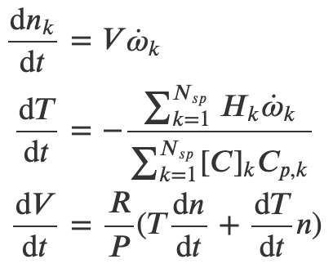
Numerics: Implicit Chemistry (3)
Some important distinctions:
PyJac-V2 implements equations that assume a reaction substep model, taking either constant-pressure/enthalpy or constant-volume/internal energy
For the time being we are using the latter
PyJac-V2 also implements the equations using the number of moles of each species as the independent variables
Constant-Volume
Constant-Pressure

Slide 30
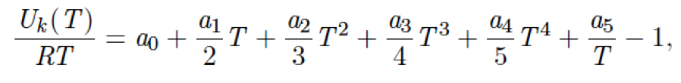
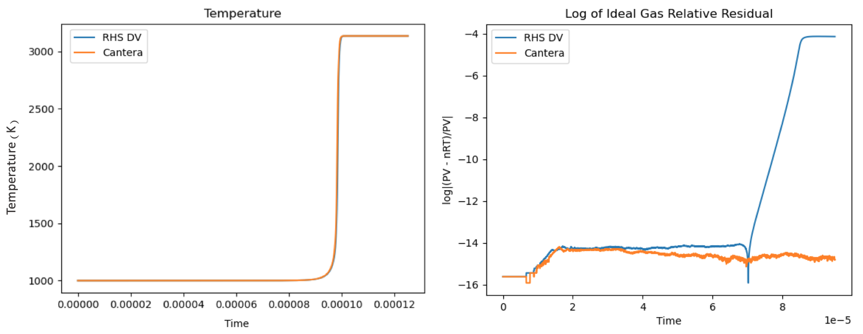
Numerics: Implicit Chemistry (4)
Critical consideration: ideal gas law drift
Time-integrating the temperature and pressure differentials no longer rigorously enforce algebraic constraints (constant internal energy, ideal gas law)

Slide 31
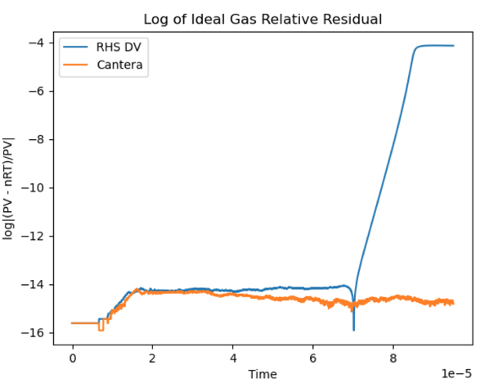
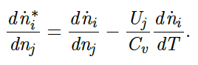
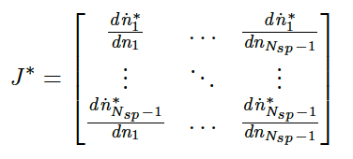
Numerics: Implicit Chemistry (5)
To mitigate this: Jacobian modification
Removes pressure and temperature rows/columns
Incorporates constant internal energy constraint into species elements
Pressure and temperature can then be updated algebraically
Additional option: RHS penalization (attenuation)

Slide 32
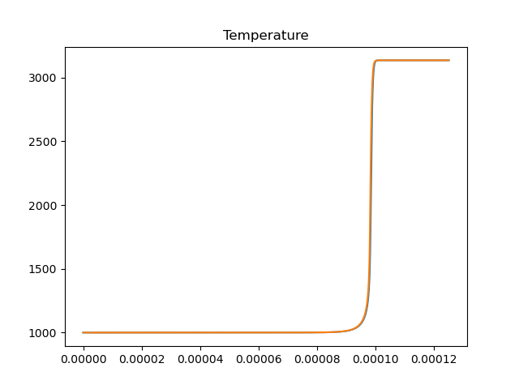
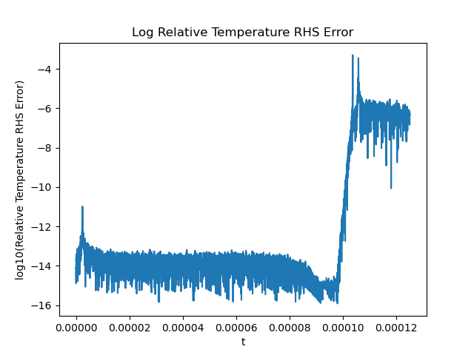
Gap: PyJac-V2 Validation
Some preliminary work – validating PyJac correctness
Source terms: direct comparison w/Cantera [9] (San Diego [10])
Jacobian: check convergence to 2nd order w/centered FD

Slide 33
Gap: PyJac-V2 Validation
Some preliminary work – validating PyJac correctness
Source terms: direct comparison w/Cantera [9] (San Diego [10])
Jacobian: check convergence to 2nd order w/centered FD

Slide 34
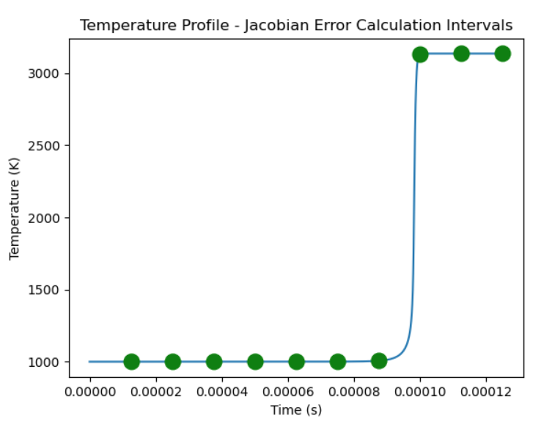
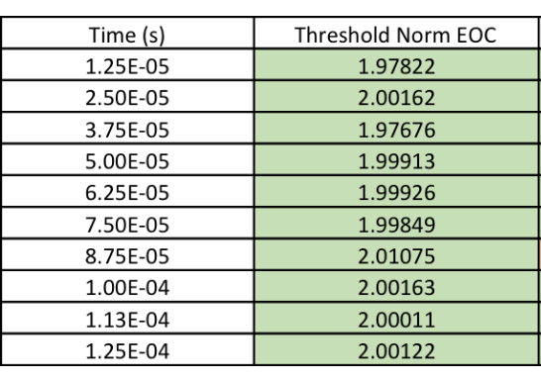
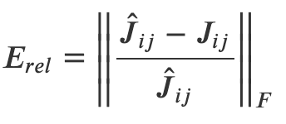
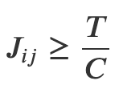
Gap: PyJac-V2 Validation
Some preliminary work – validating PyJac correctness
Source terms: direct comparison w/Cantera [9] (San Diego [10])
Jacobian: check convergence to 2nd order w/centered FD

Slide 35
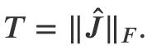
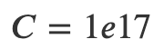
Gap: PyJac-V2 Validation
Some preliminary work – validating PyJac correctness
Source terms: direct comparison w/Cantera [9] (San Diego [10])
Jacobian: check convergence to 2nd order w/centered FD

Slide 36
Numerics: Error/Timestep Control
Motivation: reacting flow simulations, especially featuring ignition, often feature stretches of near-equilibrium chemistry punctuated by temperature/mass fraction spikes
Timestep requirements for stability/accuracy naturally vary

Slide 37
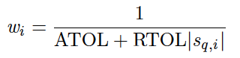
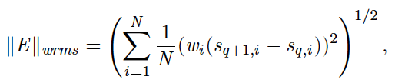
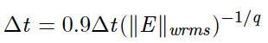
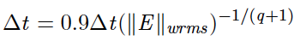
Numerics: Error/Timestep Control (2)
CVODE accounts for this by obtaining a local truncation estimate using state calculations at two differing orders – we match this approach
Similar to ODE23/ODE45 timestep adaptors, but uses weighted RMS norm to handle states with components widely varying in magnitude
State calculations for Adams methods: carry extra history value
|E|>1
|E|<1
Ablation test (VKI)

Slide 38
Numerics: Error/Timestep Control (3)
Design choices inherent to this approach:
How often to adapt the timestep (micro- vs. macrostep checks)
Error norm/adapting controller to stiffness-related situations (later)
Which state components should be included when
Timestep adaptivity vs. step ratio adaptivity
|E|>1
|E|<1
Ablation test (VKI)

Slide 39
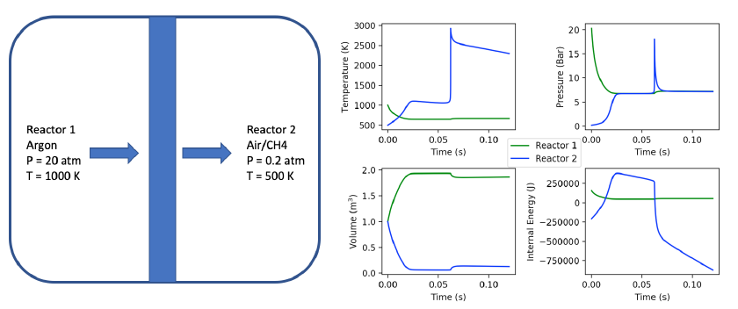
Current Status: Controller
Applying fully explicit (adaptive) integration to stiff Cantera example problem to stress-test controller
Ablation test (VKI)

Slide 40
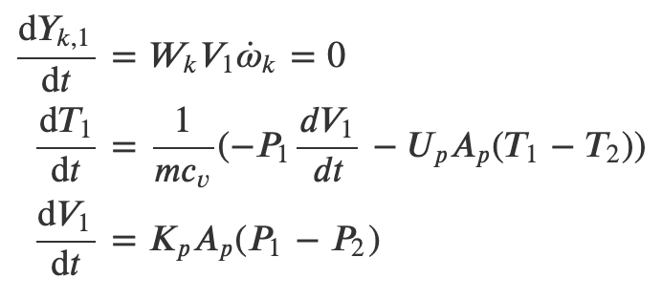
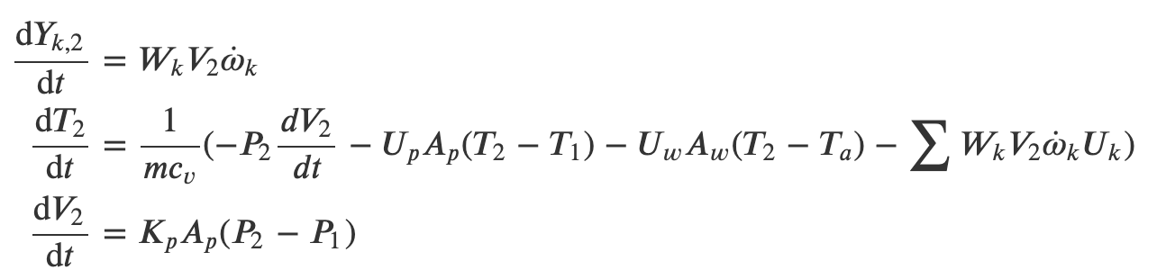
Current Status: Controller (2)
Applying fully explicit (adaptive) integration to stiff Cantera example problem to stress-test controller
Governing equations do not allow for PyJac intervention
Reactor 1
Reactor 2
Ablation test (VKI)
Ablation test (VKI)

Slide 41


Current Status: Controller (3)
Applying controller to known methods (namely embedded RK – ODE23) shows timestep “jitter” near chemical equilibrium
Floating-point issues/cancellation – documented by PyJac
Use of Scipy implementation confirms this result
Can we design a controller for integration that alleviates this?
Ablation test (VKI)
Ablation test (VKI)
Leap
Ablation test (VKI)

Slide 42

Current Status: Controller (3)
Applying controller to known methods (namely embedded RK – ODE23) shows timestep “jitter” near chemical equilibrium
Floating-point issues/cancellation – documented by PyJac
Use of Scipy implementation confirms this result
Can we design a controller for integration that alleviates this?
Ablation test (VKI)
Ablation test (VKI)
Leap
Scipy
Ablation test (VKI)

Slide 43

Demonstrative Test Problem
Target application: reacting mixing layer
Fundamentally-driven model of combustion for propulsion
Twistable speed knobs: crossflow magnitude (fluid), Arrhenius pre-exponential factors (chemistry)
Baseflow: hyperbolic tangent velocity profile (Blumen [11])
San Diego 9-species ideal gas mixture
Ignition localized to mixing layer via introduction of temperature variation
Ablation test (VKI)

Slide 44



Current Status: Test Problem
Establishing initial perturbation and subsequent growth rate that matches literature using linear stability theory
Growth rate calculations from PC2 solution use vertical velocity (no baseflow magnitude)
Formula derived from assumption that wave disturbances go like (from Blumen)
Ablation test (VKI)

Slide 45


Current Status: Test Problem
Establishing initial perturbation and subsequent growth rate that matches literature using linear stability theory
Ablation test (VKI)

Slide 46
Current Status: Synthesis/V+V
In the midst of multi-rate Adams development, implicit chemistry framework can be tested with schema existing in Leap
Generate code for chemical source terms, Jacobian, and IMEX ARK4 integration (K+C), and ”wire in” to fluid solver (PlasCom2)
Ensure that we have…
Ablation test (VKI)

Slide 47


Current Status: Synthesis/V+V
…design-order convergence for a homogeneous autoignition example (9-species San-Diego mechanism)

Slide 48
Current Status: Synthesis/V+V
…design-order convergence for a homogeneous autoignition example (9-species San-Diego mechanism) ✓
EOC: 3.89
But: case does not contain meaningful fluid motion (single-pt)
Uses Jacobian modified for explicit constraint enforcement
Ablation test (VKI)

Slide 49


Current Status: Synthesis/V+V
…good agreement with laminar flame speed returned by steady-state Cantera analysis for a freely propagating flame example✓
To-do: design order convergence in this case?
Ablation test (VKI)

Slide 50
Risk Mitigation
Important question: what if this doesn’t work out?
Reinforces CVODE as state-of-the-art for implicit treatment of chemical kinetics
Fallback: exploration of effect of analytical Jacobian versus finite difference Jacobian. Convergence effects? Performance effects?
Fallback: controller improvement. Tailoring to kinetics/mechanism?
Fallback: other target applications for implicit-explicit multi-rate
Actionable response: frontload controller design, Jacobian implementation/verification using simple(r) problems
Ablation test (VKI)

Slide 51
Outlook and Open Questions
Quantifiably characterizing benefit of analytical versus finite-difference Jacobian
Accuracy and time-to-solution (fewer implicit solve iterations)
Rigorously test effect(s) of constant-volume assumption for Jacobian
Develop error/timestep control algorithm with more robustness in the face of near-equilibrium floating point issues
Establish timescale splitting for full governing equations
Explore (large) design space
Implicit-explicit multi-rate framework
Timestep control algorithm also has “knobs” to turn
Ablation test (VKI)

Slide 52
Energy-Stable Hybrid Spatial Discretizations

Slide 53


Motivation and Background
Flow simulations incorporating complex geometries present obvious meshing challenges
Accuracy and stability can be affected by poor mesh quality
Source (L): Static Aeroelastic Analysis of an Aircraft Wind-Tunnel Model by Means of Modal RBF Mesh Updating, Biancoli et al.
Source (R): Pointwise Webinar: How to Master Hybrid Meshing for Wind Turbines, Chris Sideroff and Travis Carrigan
Ablation test (VKI)

Slide 54


Motivation and Background
One common approach: finite difference discretization(s) with some consideration for meshing near trouble regions
Curvilinear meshes w/coordinate transforms
Overset meshes
Multiblock
Source (L): Acceleration of Compressible Flow Simulations with Edge using Implicit Time Stepping, E. Otero, 2014
Source (R): Mikida et al. [3]
Ablation test (VKI)

Slide 55


Motivation and Background
Within the multiblock approach, one can opt for conforming or nonconforming interfaces between blocks
The latter provides more flexibility but arguably requires more thought
Ablation test (VKI)
Source (L): The Art and Science of Meshing Airfoils, R. Krishnamurthy, 11/6/17
Source (R): Kozdon and Wilcox [14]

Slide 56
Motivation and Background
Recent body of existing work in nonconforming interfaces, specifically w.r.t. summation-by-parts finite difference discretizations, is large
Mattsson and Carpenter (2010): fixed refinement ratio, matching corners [12]
Nissen et al. (2015): matching corners [13]
Kozdon and Wilcox (2016) [14]
Friedrich et al. (2018): degree-preserving [15]
Almquist et al. (2019): (better) degree-preserving [16]
But: can we obtain more flexible methodology?
Ablation test (VKI)

Slide 57

Motivation and Background
Another way: establish nonconforming interface between structured (SBP) and unstructured (DG) discretizations
Nordstrom and Gong (2006): low-order FD-FV [17]
Kozdon and Wilcox (2016): (same work as previous slide) – establishes provably stable interface for nonconforming interfaces between SBP discretizations and between SBP-DG discretizations, but has a number of failings
We ask (again): can we do better?
Source: Kozdon and Wilcox [14]
Ablation test (VKI)

Slide 58
The Topic/Problem
The mission statement: develop energy-stable and high-order accurate interface(s) between structured (SBP) and unstructured (DG) spatial discretizations
Remove underdetermined elements of existing interface construction(s)
Stretch goal: establish fidelity in round-trip projection
Above all: do not sacrifice provable stability
Source: Kozdon and Wilcox [14]
Ablation test (VKI)

Slide 59

Motivation and Background
Potential impact: remove troublesome geometric constraints on existing simulations, while also
Introducing ability to more readily introduce a certain discretization to a certain portion of the spatial domain
Flexible and selective application of beneficial properties of a given method to ”trouble spots” – e.g. shocks
Source: "NASA Captures First Air-to-Air Images of Supersonic Shockwave Interaction in Flight” – 3/5/2019
Ablation test (VKI)

Slide 60
In This Section…
I will be approaching this section of the talk a bit differently
Whereas the document provides a lot of the background detail on the separate discretizations/lays the groundwork for the target problem, the talk will focus more on the state of the interface
In particular, my goal is to demonstrate its weaknesses
Ablation test (VKI)

Slide 61

Governing Equations
Nonetheless, the governing equations we initially target will be used later, so they deserve mention
As with K+W, first-order wave equation in two dimensions
Worth noting: the hope is to ultimately extend interface method to
Higher dimensions
Different problems
Ablation test (VKI)

Slide 62




Demonstrating Stability
The golden rule: fully characterize an interface that is energy-stable
How to describe the energy dissipation rate at edges on the interface?
DG
SBP
Total Energy
Per-Block

Slide 63
Demonstrating Stability
Skipping over a lot of detail here, but:
Key question from here: how do we define starred quantities such that these quantities can be proven to be non-positive?
DG: numerical fluxes
SBP: SAT penalty terms
DG
SBP

Slide 64

Interface Method
This is where the interface comes in
Top-level characterization of interface: operators that project Grid A solution to Grid B (and vice versa)
Starting point for describing P: Kozdon and Wilcox
Approach has qualities we want to retain, namely energy-stability applicable to both nonconforming SBP interfaces and hybrid interfaces

Slide 65



Interface Method: Glue Grids
Primary mechanism: projecting nodal solutions (on grids) to intermediate “glue” grid
Solution on glue grid described by modal coefficients multiplying Legendre polynomials defined on [-1,1]
What results: piecewise continuous polynomial representation
Projection is then fully described by “glue-to-grid” and “grid-to-glue” operators

Slide 66
Interface Method: Glue Grids
Critical note: product of these operators is NOT assumed to be identity
Recall desire for “round-trip” projection fidelity – is this possible?
Before delving further into construction, we need to revisit the energy dissipation rates and insert definitions of interface quantities that use this nomenclature
What condition(s) for stability “pop out?”

Slide 67

Interface Method: Flux/Penalty
What will make this easier: a visual representation of one potential target simulation
Box domain split in half in x – left half employs SBP finite-difference, right half uses DG

Slide 68

Interface Method: Flux/Penalty
For a conforming SBP interface, an energy-stable definition of the SAT penalty term can be given as
Linear combination of combination of central and upwind penalties (𝜶 controls “upwindedness”)
Nonconforming interface relies on a similar principle, with the discretizations conforming at the glue-grid level

Slide 69


Interface Method: Flux/Penalty
We can describe the same penalization on the glue grid using glue grid quantities (barred):
Glue grid quantities are projected from the grid to the glue using the aforementioned operators:

Slide 70


Interface Method: Flux/Penalty
Note that surface Jacobians are also projected, along with a scaling factor

Slide 71

Interface Method: Flux/Penalty
What remains: describing SAT penalization on the grid using the glue grid penalization
Recall: projection error is nonzero
For now – assume SBP block covers entire glue grid interface (no 𝚫)

Slide 72

Interface Method: Flux/Penalty
Similarly, for a single element of DG:
No projection error – set glue space to be higher-order space than DG
Plugging these fluxes and penalties back into the edge dissipation rates provides a condition for non-positivity

Slide 73

Interface Method: Compatibility
The compatibility condition is what allows for provable energy stability
(Lengthy) proof given in Kozdon and Wilcox
Critical question: dependence on assumptions/specific formulation/governing equations?
Given its importance, this condition is considered to be an explicit constraint when constructing the operators

Slide 74


Gap: Glue-to-Glue Projection
Note: for misaligned grids, or grids with different order of accuracy, multiple glue layers are needed
Provided glue-to-glue projections satisfy their own version of compatibility, we can assume P_{f2g} projects to the finest layer without loss of generality

Slide 75


Interface Method: Construction
We will go through the basics of the operators construction and identify areas of exploration/improvement
Solution description on glue grid: piecewise continuous polynomials
𝝓: [-1,1] Legendre polynomials shifted to interval k

Slide 76

Interface Method: Construction
In the interior, assume a symmetric operator, and assume a stencil like this:
Stencils inspired by SBP interior construction

Slide 77

Interface Method: Construction
Interior and boundary order pairs match SBP as well
m = 2l
What conditions do we want to enforce in either direction with this stencil?

Slide 78

Interface Method: Construction

Slide 79

Interface Method: Construction

Slide 80

Interface Method: Construction
What results (in the interior) is in actuality an overconstrained system

Slide 81
Interface Method: Construction
Furthermore, an additional constraint is fulfillment of the compatibility condition
In practice, Kozdon and Wilcox solve for one projection operator (grid-to-glue), and obtain the other via the above condition
Major question: why are point constraints also fulfilled?

Slide 82


Interface Method: Construction
Meanwhile, what about the stencil/constraints near the boundary?
As with SBP, lower order of accuracy enforced, similar stencil (again)
(s+1)
(r)

Slide 83

Interface Method: Construction
Given the lower order enforced, as well as the expanded stencil, this is where the DOFs outstrip the constraints in total
Stencil shape and order constraints again inspired by SBP, and likely dictated by compatibility

Slide 84

Interface Method: Construction
Final operator solve is underdetermined
System closed by optimizing to bring the product of the projection operators closer to an identity
Minimize distance between nearest eigenvalues
Implication: there is more that we can ask for

Slide 85


Interface Method: Construction
Further evidence of this: applying the SBP4-2 inspired projection to an SBP-to-SBP projection of a sine wave shows high errors/unsavory behavior at boundaries

Slide 86


Interface Method: Construction
Additional experiment: what if we turn off the optimization and look at the result of the constraint solve?
Sparsity patterns at higher orders near boundary somewhat baffling
Optimization does not move character of operators far from this point

Slide 87
Interface Method: Construction
Main takeaway: construction can be improved
Constraint/compatibility solve gives an unintuitive result
We should strive to remove any optimization
Experimentation with changes in DOF pattern, additional constraints
Modifying polynomial description on the glue grid
Cannot change this at the cost of stability
Current approach: initial focus should be on interior
Far simpler, and has its own set of questions
How does compatibility influence the stencil?
What does solving for one operator and using compatibility to obtain the other say about the accuracy of each?

Slide 88
Current Status: Understanding the Interior
One useful way to explore this: fully periodic SBP-to-SBP advection example
Does compatibility condition provide the same energy stability in this case as in the first-order wave equation?
A walkthrough of this example follows

Slide 89




Current Status: Advection Demo
Insert “glue” layer into a periodic domain
Can we prove energy stability with existing operators/compatibility?
Condition on 𝝉?
Glue Grid

Slide 90




Current Status: Advection Demo
Without the glue grid, the two sides of the domain conform at the grid point level, and proof of stability follows from energy:

Slide 91



Current Status: Advection Demo
With the glue grid involved, we must examine the penalization on the glue grid interval level

Slide 92


Current Status: Advection Demo
From there, use compatibility:
This gives the same condition on 𝝉 as before, via the same analysis of principal minors to prove negative semi-definiteness

Slide 93


Current Status: Advection Demo
Validate this approach by both confirming energy ODE matches evolving energy of integrated system, and by confirming that for 𝝉 = 1, system energy decreases
Glue Grid

Slide 94
Current Status: Advection Demo
Main takeaway: keys to provable stability are use of compatibility to express energy on the glue grid level only, as well as clever “error” definition
Glue Grid

Slide 95

Demonstrative Test Problem
Initial target is the same as Kozdon and Wilcox, with split domain previously shown
(IC)
Ablation test (VKI)

Slide 96

Demonstrative Test Problem
Initial target is the same as Kozdon and Wilcox, with split domain previously shown
(Soln.)
Ablation test (VKI)

Slide 97
Risk Mitigation
Important question: what if this doesn’t work out?
Still to-do with existing operators: extension to three dimensions/additional problems
Susceptibility to geometric corner cases?
Does compatibility condition universally provide stability?
Additional question: effect on time integration
Stiffness of interface projection relative to interior/exterior boundaries
Exposure to multi-rate as needed would be straightforward
Ablation test (VKI)

Slide 98
Outlook and Open Questions
Currently: projection operator approach implemented in Python SBP-DG hybrid code
Assessed via advection and wave examples
Various concerns raised
Optimization to “close the loop” should be avoided
Sparsity of projection operators, as well as boundary behavior, is troubling
Constraints outlined in literature are in practice ignored
Critical and continuing question: how can we improve this formulation?
Additional constraints/fewer DOFs?
Rethinking compatibility as a critical condition?
Ablation test (VKI)

Slide 99
References: Time Integration of Reacting Flows
[1] Christopher A Kennedy and Mark H Carpenter. Additive runge–kutta schemes for convection–diffusion–reaction equations. Applied numerical mathematics, 44(1-2):139–181, 2003.
[2] Charles William Gear and DR Wells. Multirate linear multistep methods. BIT Numerical Mathematics, 24(4):484–502, 1984.
[3] Mikida, Cory, Andreas Klöckner, and Daniel Bodony. "Multi-rate time integration on overset meshes." Journal of Computational Physics 396 (2019): 325-346.
[4] Andreas Klöckner. High-performance high-order simulation of wave and plasma phenomena. PhD thesis, Brown University, 2010.
[5] A. Klöckner and M. Wala. Leap. https://github.com/inducer/leap, 2020.
[6] A. Klöckner and M. Wala. Dagrt. https://github.com/inducer/dagrt, 2020.
[7] Scott D Cohen, Alan C Hindmarsh, and Paul F Dubois. Cvode, a stiff/nonstiff ode solver in c. Computers in physics, 10(2):138–143, 1996.
[8] Nicholas J Curtis, Kyle E Niemeyer, and Chih-Jen Sung. Using simd and simt vectorization to evaluate sparse chemical kinetic jacobian matrices and thermochemical source terms. Combustion and Flame, 198:186–204, 2018.
[9] David G. Goodwin, Raymond L. Speth, Harry K. Moffat, and Bryan W. Weber. Cantera: An object-oriented software toolkit for chemical kinetics, thermodynamics, and transport processes. https://www.cantera.org, 2018. Version 2.4.0.
[10] San Diego Mechanism web page. Chemical-kinetic mechanisms for combustion applications.
[11] Blumen, William. "Shear layer instability of an inviscid compressible fluid." Journal of Fluid Mechanics 40.4 (1970): 769-781.
Ablation test (VKI)

Slide 100
References: Hybrid Spatial Discretizations
[12] Ken Mattsson and Mark H Carpenter. Stable and accurate interpolation operators for high-order multiblock finite difference methods. SIAM Journal on Scientific Computing, 32(4):2298–2320, 2010.
[13] Anna Nissen, Katharina Kormann, Magnus Grandin, and Kristoffer Virta. Stable difference methods for block-oriented adaptive grids. Journal of Scientific Computing, 65(2):486–511, 2015.
[14] Kozdon, Jeremy E., and Lucas C. Wilcox. "Stable coupling of nonconforming, high-order finite difference methods." SIAM Journal on Scientific Computing 38.2 (2016): A923-A952.
[15] Lucas Friedrich, David C Del Rey Fernández, Andrew R Winters, Gregor J Gassner, David W Zingg, and Jason Hicken. Conservative and stable degree preserving sbp operators for non-conforming meshes. Journal of Scientific Computing, 75(2):657– 686, 2018.
[16] Martin Almquist, Siyang Wang, and Jonatan Werpers. Order-preserving interpolation for summation-by-parts operators at nonconforming grid interfaces. SIAM Journal on Scientific Computing, 41(2):A1201–A1227, 2019.
[17] Jan Nordström and Jing Gong. A stable hybrid method for hyperbolic problems. Journal of Computational Physics, 212(2):436–453, 2006.
Ablation test (VKI)

Slide 101
BACKUP

Slide 102



Gap: Mass Diffusion
Mass diffusion: mixture-averaged model with correction term for mass conservation
X_{k}: mole fraction of species k, W: mean molecular weight, D_{k,m}: binary diffusivity coefficient
How stiff is this relative to the species production rates?
Ablation test (VKI)

Slide 103

Gap: Thermodynamic Quantities
Various thermodynamic quantities for gas mixtures: NASA 9-coefficient polynomial characterization
Unlike NASA7, supports arbitrary number of temperature regions
More accurate in cases with large temperature variation
Used to produce per-species descriptions of internal energy and specific heats at constant volume
Totals for mixtures can be obtained using these quantities in conjunction with species concentrations
Ablation test (VKI)

Slide 104







Gap: Attenuation
Alternative approach to fully differential or differential/algebraic approaches to chemistry: attenuation
Penalize fully differential approach with RHS term forcing to manifold
Good resource: Ascher and Petzold (1998)

Slide 105



Gap: Attenuation (2)
Alternative approach to fully differential or differential/algebraic approaches to chemistry: attenuation
Penalize fully differential approach with RHS term forcing to manifold
Good resource: Ascher and Petzold (1998)

Slide 106
Implementation: Code Generation
Leap: method descriptor for time-stepping methods
Written in Python
Can be used by method designers to develop novel integrators for various applications
Uses a virtual machine to describe both implicit and explicit methods in the form of instructions
Dagrt: generates Fortran, Python, or C++ code using Leap instructions
PyJac-V2: generates OpenCL/C++ code for chemical sources/Jacobians
PlasCom2: compressible fluid solver with overset grid capabilities (C++/Fortran)
Method: Leap
Codegen: dagrt
C++/Fortran Code
PlasCom2
Mech: Cantera
Codegen: PyJacV2

Slide 107



Interface Method: Construction
Further evidence of this: applying the SBP4-2 inspired projection to an SBP-to-SBP projection of a sine wave shows high errors/unsavory behavior at boundaries

